Slide 1
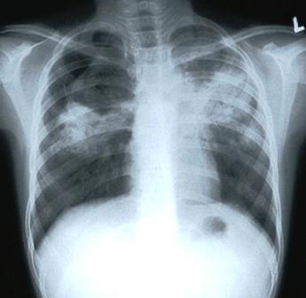
Notes:
What’s wrong with this? –

Slide 2
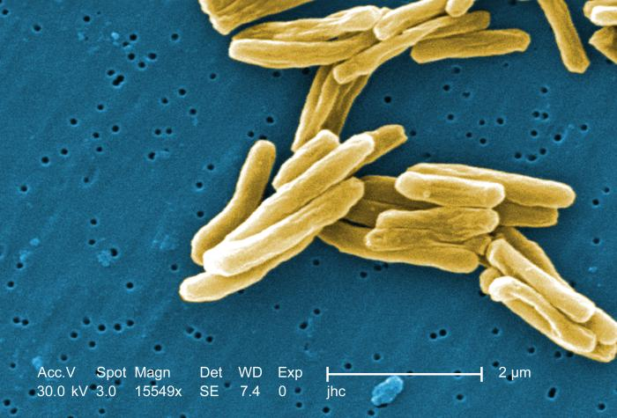
The Culprit[2]
Notes:
Some properties of TB – promising target is cell wall, but TB has sludgy outer lipid layer, making it difficult; TB forms granulomas in the lung (1st image)
MOST IMPORTANT IS OUTER LIPID LAYER

Slide 3
What is TB?[3,4]
Infectious disease caused by Mycobacterium tuberculosis
Symptoms:
Cough
Weight loss
Fatigue
Fever
Night sweats
Chills
Appetite Loss

Slide 4
TB Impact Factor[5]
1/3 of word population is infected
MDR-TB is emerging
Treatment requires heavy antibiotic regimen
2011 – 9 million sick, 1.4 million killed by TB
Affects those with HIV
Infections usually kept latent through immune system

Slide 5
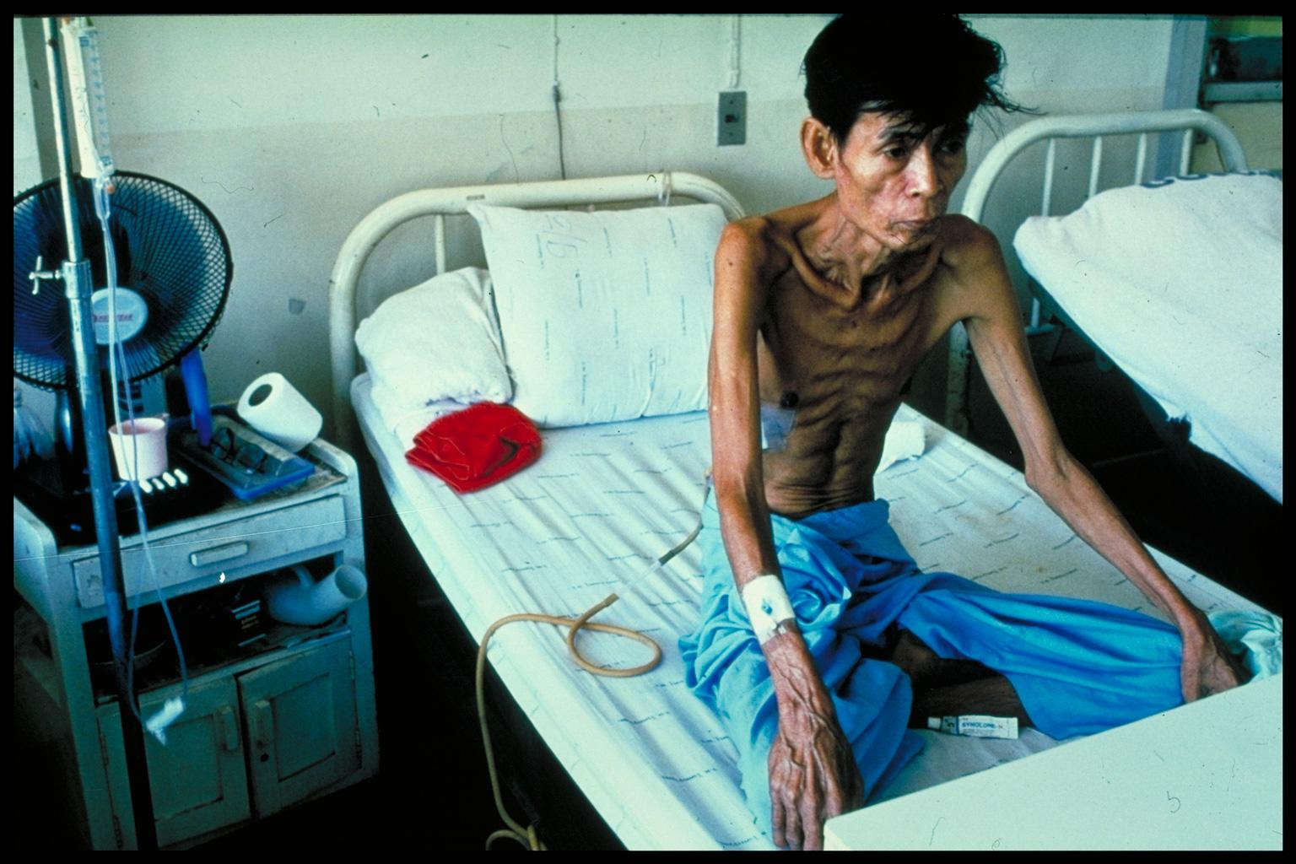
Who’s hit the hardest?[6]
Thai man with HIV and TB
Notes:
TB prevalence displays bias towards certain groups -- Those with HIV, 3rd world countries, especially with overcrowding, smokers (therefore industrial)

Slide 6
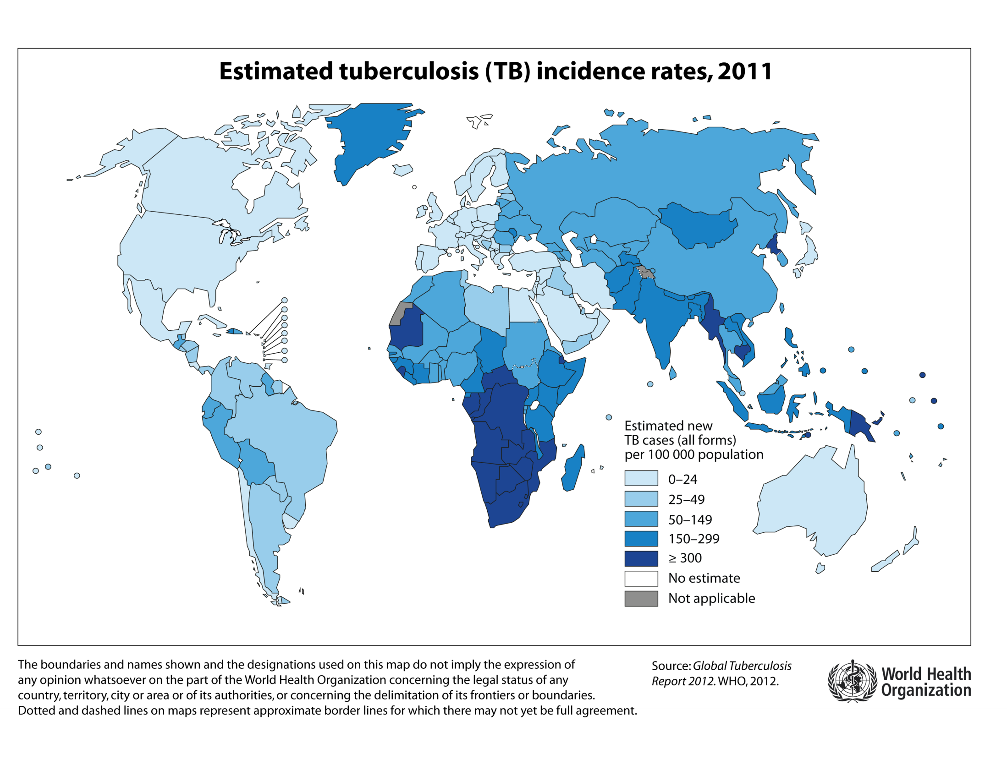
Along Geographical Lines

Slide 7
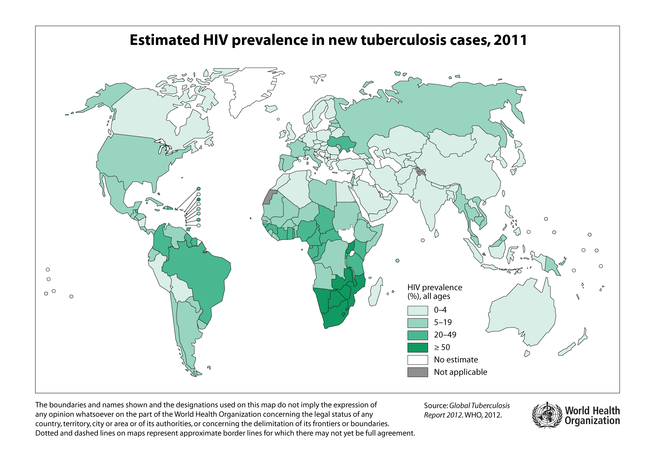

Slide 8
Diagnosis/Treatment is Difficult[7,8,9]
Current diagnosis methods involve sputum microscopy
TB Mantoux Test
Replaced Heaf Test
Treatment involves multiple drug regimens
Almost year long
MDR-TB risk

Slide 9
Current Work/New Ideas[10,11]
Beatty, K. E. et al. Sulfatase-activated fluorophores for rapid discrimination of mycobacterial species and strains. Proc. Natl. Acad. Sci. U. S. A. 2013, 110, 12911-12916.
Siegrist, M. S. et al. D-Amino Acid Chemical Reporters Reveal Peptidoglycan Dynamics of an Intracellular Pathogen. ACS Chem. Biol. 2013.8, 500-505.
Sarah Stanley, UC Berkeley SPH – too many cool pubs to list
Inhibiting outer lipid layer formation, how virulence factors in Mtb turn on...
Can we adapt our diagnostics to the outer lipid layer?
Test for bacterial activity using hydrophobic probes?
Fluorescence from immune response?

Slide 10
Works Cited
Cover Slide: http://health.utah.gov/cdc/tbrefugee/images/Chest%20X-Ray%20with%20TB.jpg
http://textbookofbacteriology.net/MTBCDC.jpg
http://en.wikipedia.org/wiki/Tuberculosis#cite_note-Robbins-1 (Pathology textbook)
http://www.mayoclinic.com/health/tuberculosis/DS00372/DSECTION=symptoms
http://www.cdc.gov/tb/statistics/
Image: http://blogs.nature.com/news/files/2013/04/HIV_TB.jpg.jpeg
http://en.wikipedia.org/wiki/Tuberculosis
http://www.cdc.gov/tb/topic/treatment/default.htm
Image: http://theroanokestar.com/wp-content/uploads/2013/08/Money.jpg
http://www.cchem.berkeley.edu/crbgrp/publications.htm
http://sph.berkeley.edu/sarah-stanley

Slide 11
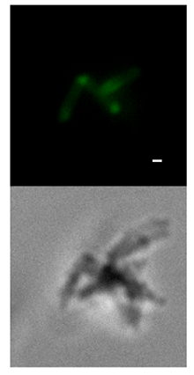
Supplemental Image: TB imaging
Siegrist, M. S. et al. d-Amino Acid Chemical Reporters Reveal Peptidoglycan Dynamics of an Intracellular Pathogen. ACS Chem. Biol. 2012, 8, 500−505.

Slide 12
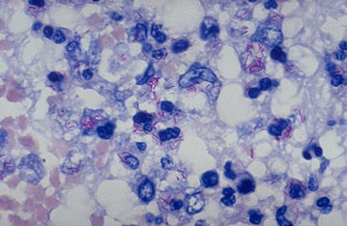
Supplemental Image:
TB diagnostics imaging using Ziehl-Neelsen Acid Fast Stain
Source: Oxford Immunotec

