Slide 1
The Human Microbiome
Jenna Pinkham

Slide 2
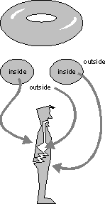
You are only 10% human
Bacteria, viruses, fungi, and various microbes cover every inch of the surface of you body—skin, mouth, sinuses, lungs, intestines, etc.
(Think of the body as donut-shaped: you have surfaces on both the “outside” and the “inside”)
Each part of your body is like a different ecosystem —your elbow skin is different from your finger skin is different from your tongue…
Microbes outnumber your human cells by about 10:1
Everyone’s microbiome is unique to them
You couldn’t get rid of all your germs even if you tried

Slide 3
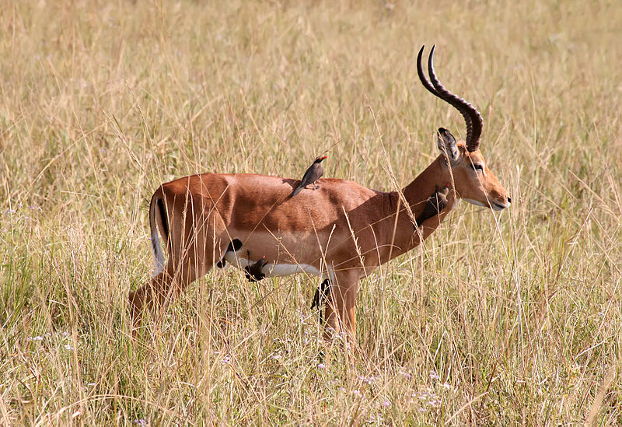
Not all bacteria are bad
The majority of the bacteria in/on your body are:
Commensals: “generally harmless freeloaders”
Mutualists: “favor traders”
Ex: bovine and termite gut flora help their hosts break down cellulose, which the hosts can’t do on their own
Pathogens are bad—but your own microbiome acts as a defense against them
Competition for space and resources
Mutualism: red-billed oxpecker eats ticks off an impala’s coat

Slide 4
Mutualism
Immune function
Bacteria in our bodies compete for resources just like animals outside compete
Mutualistic bacteria can prevent invading microbes from taking hold and can even render an environment inhospitable to foreigners
Can digest the foods we lack the enzymes for
Provide 10-15% of our calories
Manufacture of substances
Neurotransmitters
B-vitamins and K-vitamins
Important amino acids
Short-chain fatty acids
Signalng chemicals to regulate appetite and digestion
In return, we provide bacteria with food and shelter

Slide 5
A healthy microbiome?
Still early in the research—scientists reluctant to describe what a healthy microbiome looks like
Impoverished “Westernized microbiome” is distinctly different than the microbiomes of rural Africans and Indigenous communities in South America (some of which have had limited contact with the Western world)
Core principles of ecology still hold
Diversity is good, as diverse ecosystems are more resilient than those with relatively low biodiversity
Microbes fill specific niches within your internal ecosystem, making the introduction of newer species difficult (but not impossible)
Environmental factors (diet, antibiotics) have a huge impact on population levels
Very complex relationship between microbiome and host

Slide 6
What can influence your microbiome
Diet
Processed foods (sterile)
Antimicrobials
Pesticides
Meat-based vs. plant-based
Diversity
Sex hormones
The microbiome of your birth mother
Whether or not you were breastfed
Whether you were delivered vaginally or via C-section
How many different people held you as a baby
Whether or not you've recently been on antibiotics
How many times you’ve taken antibiotics
Certain medical procedures
Radiation therapy
The presence of a family dog

Slide 7
Illnesses associated with an specific microbiome populations
Autoimmune disorders
Diabetes
Celiac disease
Allergies
Heart disease
Infections
Clostridium difficile
Vaginal infections
Metabolic Syndrome
Inflammatory diseases
Crohn’s disease and colitis
Asthma
Multiple Sclerosis
Obesity
Certain cancers
Autism
Kwashiorkor
Severe, deadly form of malnutirion

Slide 8
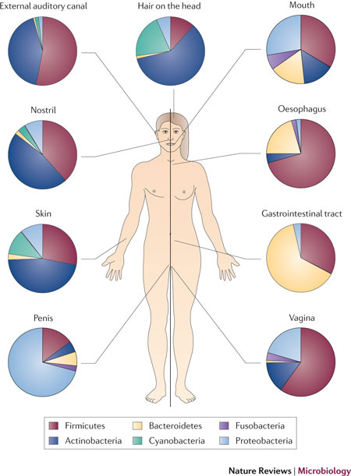
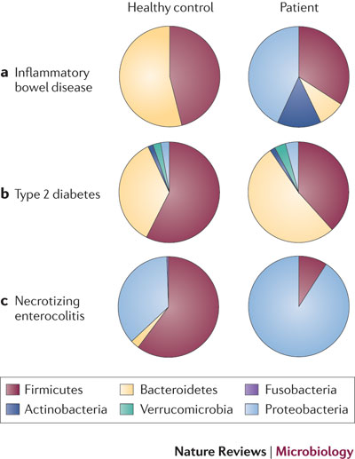

Slide 9
Future applications in health
More research is needed, and researchers are wary about overstating the benefits that can be derived from learning to manipulate the human biome
Still, manipulation of the microbiome has proved beneficial in a number of cases

Slide 10
Fecal Transplants
Transplanting the microbiome from one organism to another
Really need a new name
Used in the treatment of C. difficile infections in humans
Fecal transplants in rats
Gut flora from human twins where one twin was obese and the other thin were transplanted into genetically-identical rats born and kept in a sterile environment. Mice given the gut flora of the obese twin weighed nearly 20% more than mice given the gut flora of the thin twin.
Mice then put in cages together, causing microbiome-sharing. When fed a low-fat diet the gut flora of the fat mice were replaced with those of the thin human twin, and the fat ones lost weight. When fed a high-fat diet, the fat mice maintained the microbiomes of the obese human twins.

Slide 11
Probiotics and Prebiotics
Probiotics: ingestible good-for-you bacteria (like in yogurt)
Can be used to introduce bacteria into a microbiome lacking in a specific species
Probiotic bacteria often do not stick around in your GI tract, but may influence your microbiome though horizontal gene sharing
Prebiotics: substances that feed the good-for-you bacteria
Can make your ecosystem more favorable to specific bacteria, which can displace harmful ones and nurture microtomes in children
Some scientists believe a combination of the two can be used to deliberately alter people’s micro biomes to be more beneficial to overall human health

Slide 12
Bibliography
Charles, Dan. "Gut Microbes May Play Deadly Role In Malnutrition." NPR. NPR, 30 Jan. 2013. Web. 29 Sept. 2013.
Charles, Dan. "What Our Gut Microbes Say About Us." NPR. NPR, 9 May 2012. Web. 29 Sept. 2013.
Karim, Muhammad Mahdi. An Impala at Mikumi National Park. 2008. Photograph. Mikumi National Park, Tanzania.
Kolata, Gina. "Gut Bacteria From Thin Humans Can Slim Mice Down." The New York Times. The New York Times, 5 Sept. 2013. Web. 29 Sept. 2013.
Pollan, Michael. "Some of My Best Friends Are Germs." The New York Times. The New York Times, 15 May 2013. Web. 29 Sept. 2013.
Samsel, Anthony, and Stephanie Seneff. "Glyphosate’s Suppression of Cytochrome P450 Enzymes and Amino Acid Biosynthesis by the Gut Microbiome: Pathways to Modern Diseases." Entropy 15.4 (2013): 1416-463. Print.

Slide 13
Bibliography (con’t)
Smif, Pete. Human Topology. Digital image. N.p., 22 Nov. 2007. Web. 29 Sept. 2013.
Spor, Aymé, Omry Koren, and Ruth Ley. "Unravelling the Effects of the Environment and Host Genotype on the Gut Microbiome." Nature 9 (2011): 279-90. Web. 29 Sept. 2013. <http://www.nature.com/nrmicro/journal/v9/n4/full/nrmicro2540.html>.
Sposito, Garrison, and Robert Hass. "Ecosystem Structure and Function." Introduction to Environmental Studies (ESPM 12/English 77). UC Berkeley, Berkeley. 17 Sept. 2013. Lecture.
Stein, Rob. "From Birth, Our Microbes Become As Personal As A Fingerprint." NPR. NPR, 9 Sept. 2013. Web. 29 Sept. 2013.
Stein, Rob. "Microbe Transplants Treat Some Diseases That Drugs Can't Fix." NPR. NPR, 9 Sept. 2013. Web. 29 Sept. 2013.
Zimmer, Carl. "Human Microbiome May Be Seeded Before Birth." The New York Times. The New York Times, 29 Aug. 2013. Web. 29 Sept. 2013.

