Slide 1
Malaria
EWH 2013
by Chris Lew

Slide 2
History of Malaria
Malaria- “mal” (bad) “aria” (air)
Symptoms first described by Hippocrates in 400 B.C.E.
Ronald Ross receives Nobel Prize (1902) for isolating Anopheles mosquitoes as the insect vector and demonstrating the “mosquito-human-mosquito” cycle
Charles Laveran receives Nobel Prize (1907) for tracing cause back to protozoan organism Plasmodium
Was endemic to New England in the 19th century, major cause of morbidity during the American Civil War

Slide 3
Distribution and Impact
Primarily a disease of the tropics
5th leading cause of death in the world
Estimated 216 million infections per year, 655,000 deaths per year
90% of deaths in Sub-Saharan
Africa are children <5 yrs old
Exacerbated by socioeconomic
issues in developing countries
Up to 40% of public health
expenditures in some countries

Slide 4
The Culprit
Only female mosquitoes of the genus Anopheles can spread malaria
Primary vector: Anopheles gambiae
  Can bite 5-20 people in one night
  Native to Africa and South America
There are other species that transmit
the disease (e.g. A. freeborni, A. albimanus)
that live in the U.S. and Europe

Slide 5
The Real Culprit
Malaria is an intracellular protozoan parasite
There are 4 species of Plasmodium
that cause malaria in humans
  P. falciparum (80-85%)
  P. vivax
  P. ovale
  P. malariae
Infects RBCs, making parasite relatively easy to find in the blood
Plasmodium’s diet is primarily hemoglobin
By living in RBCs, the parasite evades key adaptive immune responses by the Cytotoxic T-lymphocytes (CTLs)
RBCs don’t express MHC Class I, can’t activate CD4+/CD8+ receptors on T-cells

Slide 6
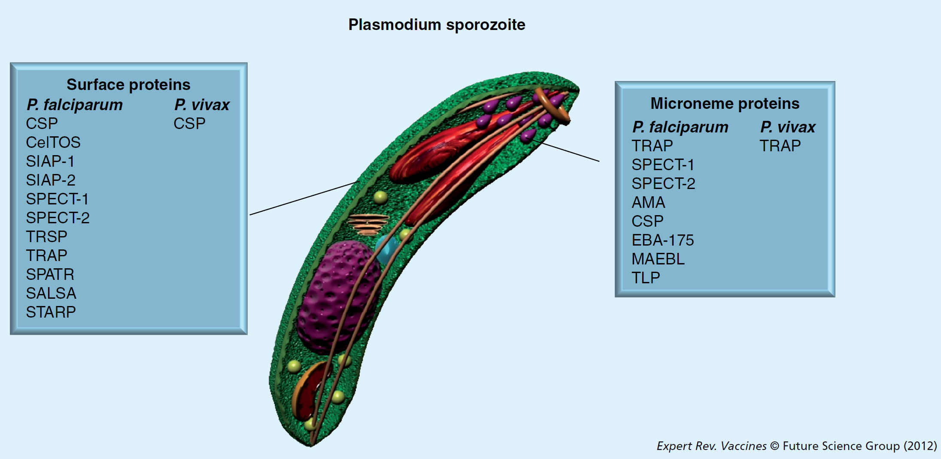
Sporozoites
Immature forms of the Plasmodium parasite
Live commensally in the saliva of
Anopheles mosquitoes
Later mature into schizonts in the
liver (~7 days), and finally into
merozoites (~14 days)
which will go on to infect RBCs

Slide 7
Merozoites
Merozoites typically undergo many rounds of replication in RBCs
Parasites can infect up to 60% of RBCs
Merozoite releases (every 48-72 hours)
cause cyclic and systemic
fever/chill phases

Slide 8
Transmission Cycle
10,000-30,000 merozoites/liver cell
Disease only commences once parasite replicates in RBCs
Reinfection of mosquito via second biting event

Slide 9
Symptoms
Characteristic spiking fever with 48-72 hour periodicity
Extreme heat and chill spells
Children often affected by cerebral malaria, when brain swells and hemorrhages, causing extreme neurological damage or death
In endemic areas, almost 100% of children have yearly symptomatic malaria, but only 1-2% have severe complications
Partial immunity: most adults in endemic areas will be infected at least 2 times within their lives, but only 70% experience symptoms, and less than 1% die
Can be fairly easily detected and diagnosed via blood smear assay
<1% deaths
70% symptomatic
30% asymptomatic

Slide 10
Treatment
European imperialism, “Scramble for Africa” in late 19th century
“The Dark Continent”, “White Man’s Disease”
Discovery of quinine in Chinchona bark as a prophylactic treatment
Quinine-derived compounds (chloroquine, mefloquine, Malarone®)
Common antibiotics (doxycycline, tetracycline, clindamycin)
Permethrin bed nets (most popular and PH-effective method)
  In one large trial, child malarial deaths were reduced by 22%
Heterozygous sickle-cell anemia carriers (HbS) have immunity
Pesticides? DDT and Fred Soper in 1950s

Slide 11
Recent Increase in Malaria
1) Increased drug resistance.
  Overuse of chloroquines
2) Insecticide resistance
  Resistance to pyrethoid insecticides used on bednets
3) Environmental changes
  Human impact from damming and agricultural flooding leads to increased mosquito breeding grounds
4) Civil unrest
  Reduced public health intervention
5) Travel
  Increased travel between malaria-endemic countries and relatively malaria-free countries has facilitated transmission

Slide 12
Works Cited
Beatty R, Vance R. MCB 55 (Lec 13, 14: Malaria).
http://www.rbm.who.int/ProgressImpactSeries/report1.html
http://www.cdc.gov/malaria/about/biology/
http://www.miguelprudencio.com/Plasmodium%20sporozoite-3.jpg
http://www.britannica.com/EBchecked/topic/561020/sporozoite

