Slide 1
Measles
A Public Health Presentation by
Cindy Mui

Slide 2
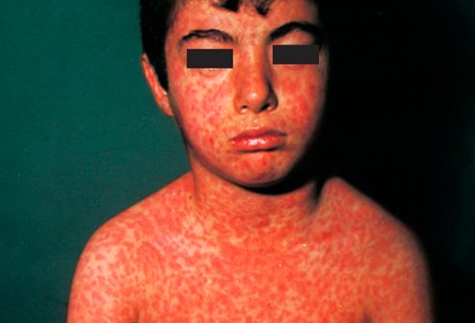
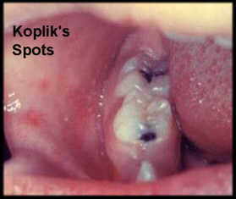
What is it?
A respiratory disease
Caused by a virus of the same name, also known as rubeola
People who recover from measles are immune for the rest of their lives
Symptoms include fever, runny nose,
blotchy rash all over the body, cough,
red, watery eyes, Koplik’s spots

Slide 3
Diagnosis & Risk Factors
Three days of fever with at least one of the following: cough, conjunctivitis, coryza or observation of Koplik spot
Severe complications are usually found in poorly nourished young children with Vitamin A deficiency or immunodeficiency (such as those with HIV/AIDS)
Pregnant women who are infected are also at risk of severe complications and the pregnancy may end in miscarriage or preterm delivery

Slide 4
Transmission
Usually spreads through the air by breathing, coughing or sneezing
Can spread to others from 4 days before to 4 days after rash erupts
Measles are so highly contagious that 90% of people close to an infected who is not immune will also become infected.
The virus lives in the mucus in the nose and the throat of an infected person
Can live in the air or on infected surfaces for up to 2 hours
Spreads through only humans

Slide 5
Complications
SSPE (subacute sclerosing panencephalitis) (one out of 1000)
Pneumonia (one out of 20)
Bronchitis
Ear infections (up to 1 in 10 children)
Diarrhea
One or two out of 1000 die, and most deaths are caused by complications

Slide 6
Treatment & Prevention
There is no treatment for measles. Usually just supportive care, and the patient recovers on his/her own if there are no complications.
Vitamin A supplements are provided to restore low Vitamin A levels and help prevent eye damage and blindness
Supplements have been shown to reduce number of deaths from measles by 50%
Acquire adequate fluid intake to replace lost fluids from diarrhea or vomiting
Antibiotics for pneumonia, bronchitis, and etc.
Routine vaccination for children is the only way for prevention (Two doses to ensure immunity)

Slide 7
From past…
First scientific description of measles was around the 9th century when an Arab physician explained the difference between smallpox and measles
Most devastating to populations not exposed to measles before; after exposure populations develop resistance
In 1954, the virus was isolated and propagated on tissue culture
21 strains of the virus have been found since then
Vaccines became available in 1963
Notes:
1529: measles outbreak in Cuba killed 2/3 of population that had survived smallpox
1531: measles killed half the population of Honduras, and also ravaged Mexico, Central America, the Inca civilization

Slide 8
..to present
Declared eliminated in the U.S. in 2000, but 189 people reported to have the disease in 2013 (but usually because of
Measles is still named as the leading cause of childhood mortality even though a cost-effective vaccine is available
Kills an estimated amount of 160, 000 people in the world yearly, but this is an improvement from the 548 000 children that died in 2000
Still highly endemic in developing countries; more than 20 million people are infected each year, and majority of deaths (95%) occur in countries with low per capita incomes and weak health infrastructure

Slide 9
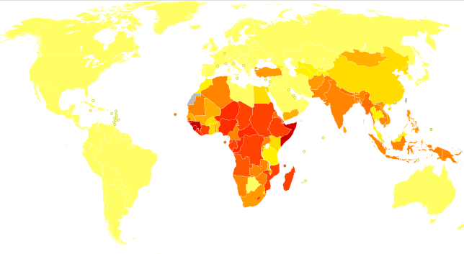
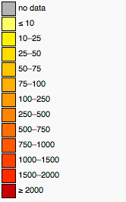

Slide 10
Bibliography
http://en.wikipedia.org/wiki/Measles
http://www.cdc.gov/measles/about/overview.html
http://children.webmd.com
http://www.who.int/mediacentre/factsheets/fs286/en/index.html

Slide 11
Thanks for listening ☺
Any questions?

