Slide 1
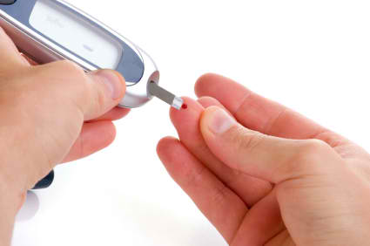
Diabetes
By: Eric Horton

Slide 2
What is Diabetes?
Caused by increased level of blood glucose level
Increased blood sugar level can hurt blood vessels
3 Types of Diabetes and 1 Precursor
Prediabetes
Type 1 Diabetes
Type 2 Diabetes
Gestational Diabetes

Slide 3
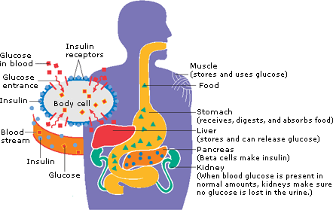
Insulin
Hormone used to convert sugar and starches to energy
Also stores energy in muscles, fat, and liver for future use
Beta cells in pancreas create it
Blood glucose rises when you eat
Pancreas is triggered to release insulin in bloodstream
Insulin travels to cells and tells them to accept glucose
Cells accept convert glucose to energy or store for later use

Slide 4
Symptoms
Urinating a lot
Constant thirst
Feeling hungry often
Fatigue
Blurry vision
Slow healing (cuts and bruises)
Weight Loss
Tingling or numbness in hands and/or feet

Slide 5
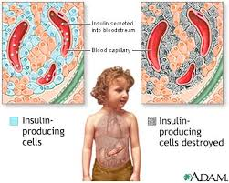
Type 1
Diagnosed in children and young adults
Beta cells which make insulin have been destroyed
Accounts for 5% of people with diabetes
Required to take insulin shots

Slide 6
Type 2
Insulin is made but the body develops a resistance to it
Pancreas responds by creating more insulin
Eventually pancreas cannot keep up and have elevated blood glucose levels
Caused by:
Family history and genes play a role
Little exercise
Poor diet
Excess body weight around waist

Slide 7
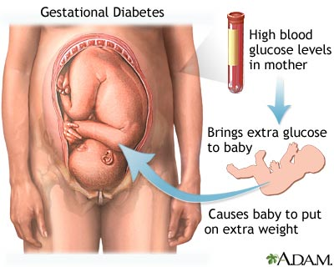
Gestational
Occurs during pregnancy during 24th week
Can occur for people with or without diabetes
Placenta supports baby’s growth but also produces certain hormones
These hormones can block insulin in her body
May need 3x insulin
Baby can have too much glucose in body and have to make extra insulin
Excess energy for babies is stored as fat

Slide 8
Prediabetes
No clear symptoms
People usually have this before Type 2 Diabetes
Ways to Prevent
Losing body weight (7%)
Exercise moderately (30 min/day 5 days/week)
Lowers risk by 58%

Slide 9
Statistics - Population
Total People with Diabetes in US – 25.8 million (8.3%)
Prediabetes – 79 million
Gender
Male – 13 million (11.8%) age 20 and over
Female – 12.6 million (10.8%) age 20 and over
Race
Non-Hispanic whites – 7.1%
Asian Americans – 8.4%
Non-Hispanic blacks – 12.6%
Hispanic – 11.8%
Costs $246 billion in US in 2012

Slide 10
Statistics – Complications from Diabetes
Heart Disease/Stroke
2-4x more likely to develop heart disease or get a stroke
High Blood Pressure
67% of people had high blood pressure (over 140/90 mmHg)
Blindness
700,000 had advanced retinopathy which can lead to vision loss
Kidney Disease
44% of new cases were due to diabetes in 2008
Nervous System Disease
60-70% have some nervous system damage
Amputation
60% of non-traumatic lower-limb amputations are with people with diabetes

Slide 11
Resources
http://www.diabetes.org/?loc=logo
http://www.ghc.org/popup.jhtml?item=/common/healthAndWellness/conditions/diabetes/insulinProcess.html

