Slide 1
Cardiovascular Diseases
Eric Huang
Engineering World Health

Slide 2
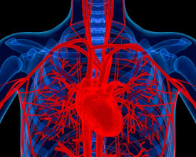
Overview of CVD
Leading cause of death worldwide.
More than a third of deaths from CVD.
$400 billion in annual medical costs.
1 in 3 Americans have some form of CVD.
http://www.nhlbi.nih.gov/news/spotlight/success/conquering-cardiovascular-disease.html

Slide 3
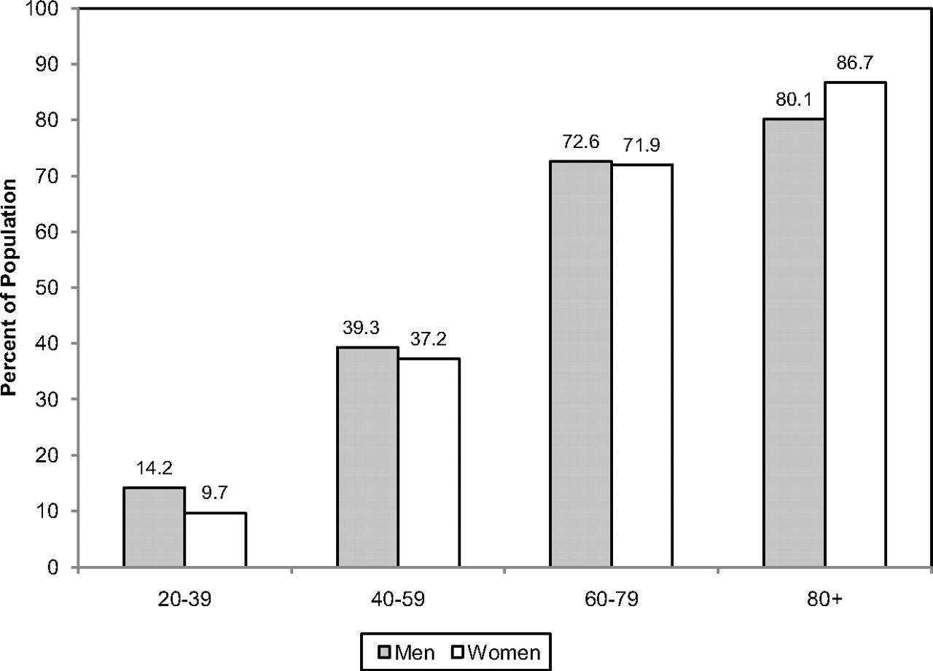
Prevalence by Age
Roger VL, Go AS, Lloyd-Jones DM, et al. Heart disease and stroke statistics—2011 update: a report from the American Heart Association. Circulation. 2011;123:18-209.

Slide 4
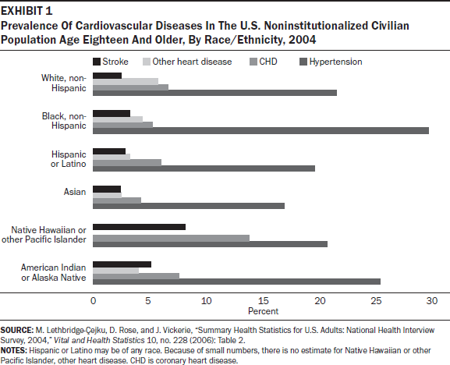
Prevalence by Ethnic Group
Mensah GA, Brown DW. An overview of cardiovascular disease burden in the United States. HealthAffairs. 2007;26(1):38-48.

Slide 5
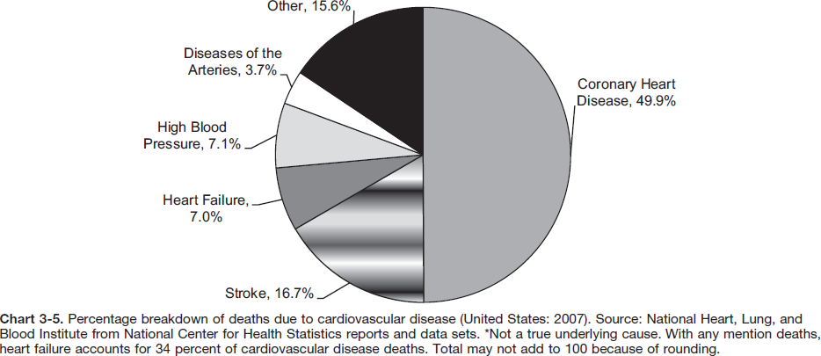
CVD Breakdown
Roger VL, Go AS, Lloyd-Jones DM, et al. Heart disease and stroke statistics—2011 update: a report from the American Heart Association. Circulation. 2011;123:18-209.

Slide 6
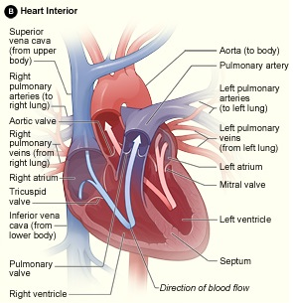
Heart
Four chambers, two atria and two ventricles.
Deoxygenated blood enters right atrium, oxygenated blood leaves left ventricle.
Heart valves ensure unidirectional blood flow.
http://www.nhlbi.nih.gov/health/health-topics/topics/hhw/anatomy.html

Slide 7
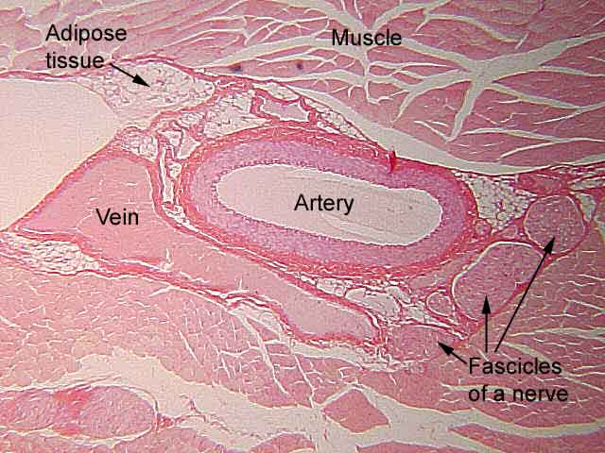
Blood Vessels
Arteries carry blood away from the heart.
Veins carry blood towards the heart.
Capillaries allow exchange of substances between blood and tissue cells.
http://www.niagaracc.suny.edu/academics/shm/val/arteryvn.html

Slide 8
Arrhythmia
Irregular heartbeats due to abnormal electrical impulses.
http://physionet.org/tutorials/cv/

Slide 9
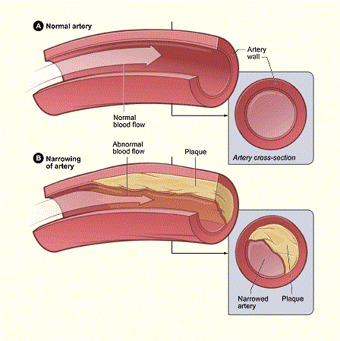
Atherosclerosis
Artery narrowing reduces blood flow.
Plaque can break off and result in an embolism.
Associated with high LDL cholesterol levels.
http://www.nhlbi.nih.gov/health/health-topics/topics/atherosclerosis/

Slide 10
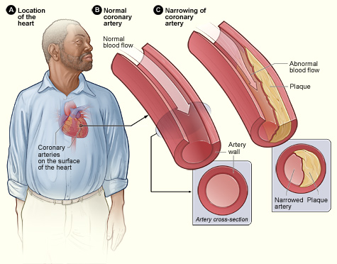
Coronary Artery Disease
Most common type of heart disease.
Atherosclerosis of the heart deprives heart muscle of oxygen.
Precursor to angina and heart attacks.
http://www.nhlbi.nih.gov/health/health-topics/topics/cad/

Slide 11
Congestive Heart Failure
Heart unable to pump blood efficiently.
Insufficient cardiac output.
Causes fluid buildup in other parts of the body.

Slide 12
Hypertension
Blood pressure consistently above 140/90 mmHg.
Weakens blood vessels and accelerates atherosclerosis.
Contributes to aneurysm formation.

Slide 13
Stroke
Interrupted blood flow to the brain.
Ischemic strokes arise from embolisms or thrombi blocking blood vessels.
Hemorrhagic strokes result from rupturing of blood vessels.

Slide 14
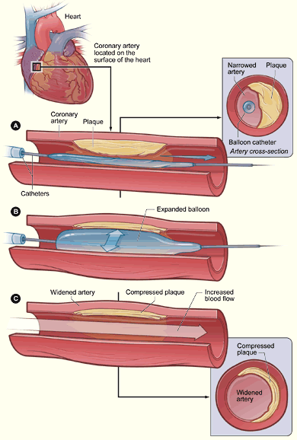
Angioplasty
Widens blocked artery to restore blood flow.
http://www.nhlbi.nih.gov/health//dci/Diseases/Angioplasty/Angioplasty_All.html

Slide 15
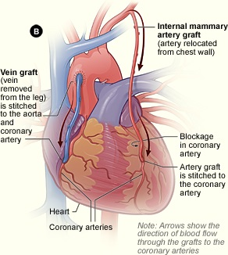
Heart Bypass Surgery
Reroutes blood flow around blocked blood vessel using vascular grafts.
http://www.nhlbi.nih.gov/health/health-topics/topics/cabg/

Slide 16
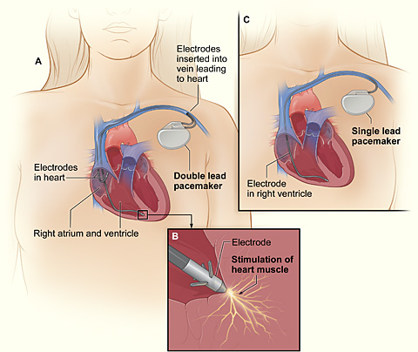
Pacemakers
Normalizes heart rhythm by delivering electrical impulses to the heart.
http://www.nhlbi.nih.gov/health/health-topics/topics/pace/printall-index.html

